Slide 1
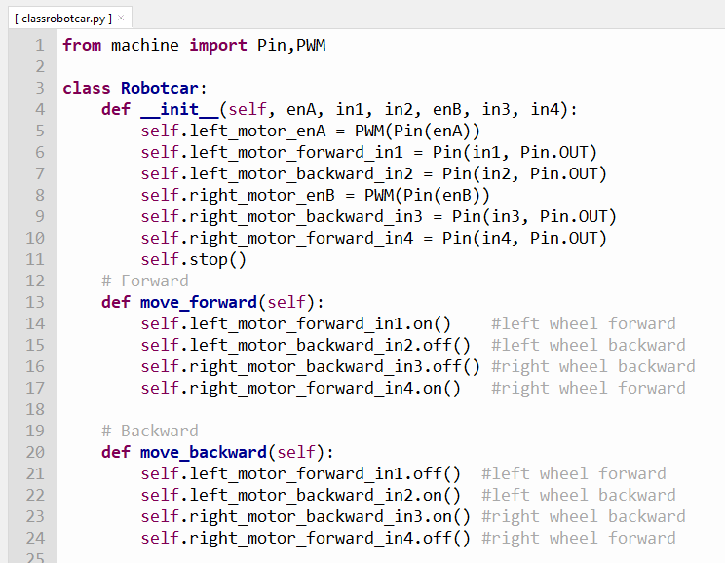
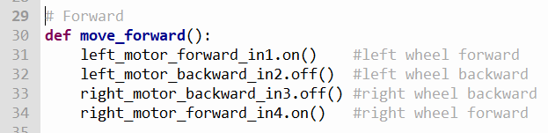
CLASSES IN PYTHON
robot.move_forward()
robotcar
If I share my class with you

Slide 2
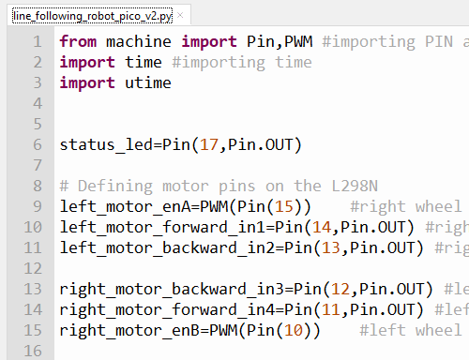
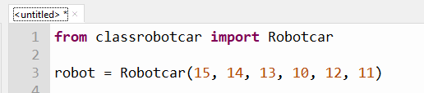
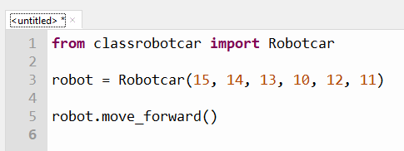

Slide 3
The Robotcar class
It’s just a recycleable python program – classrobotcar.py
Contained with it is the robot class
Review of classrobotcar.py
classrobotcar.py
class Robotcar……
def move_forward()
def move_backward()
def turn_left()
def turn_right()
def stop()
from classrobotcar import Robotcar

Slide 4
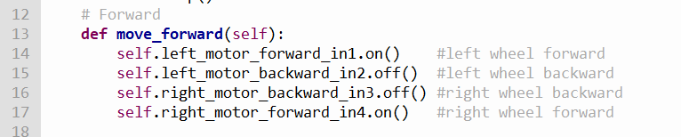
The Robot class has 5 modules or methods
move_forward(self)
move_backward(self)
turn_left(self)
turn_right(self)
stop(self)

Slide 5
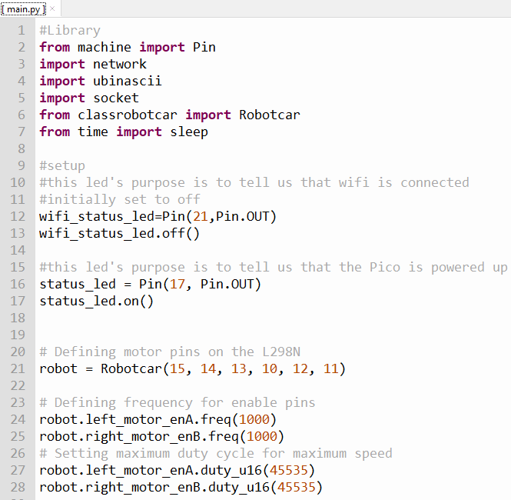
Robby_with_class.py

Slide 6
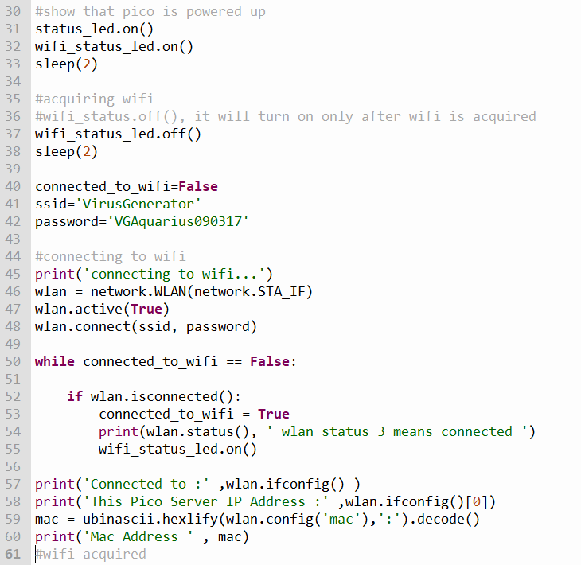
Robby_with_class.py

Slide 7
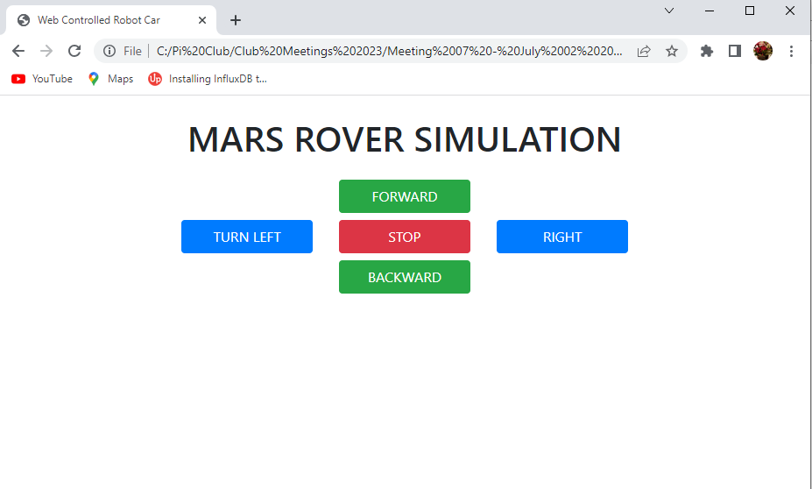
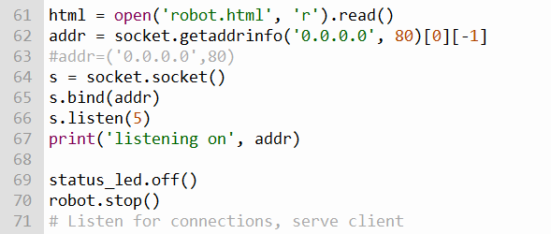
192.168.0.243
IP ADDRESS OF THE PICO ON THE ROBOT
GENERATED USING CHATGPT

Slide 8
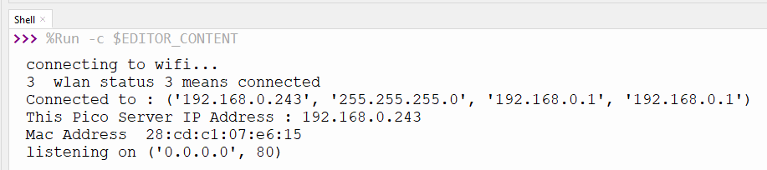
192.168.0.243

Slide 9
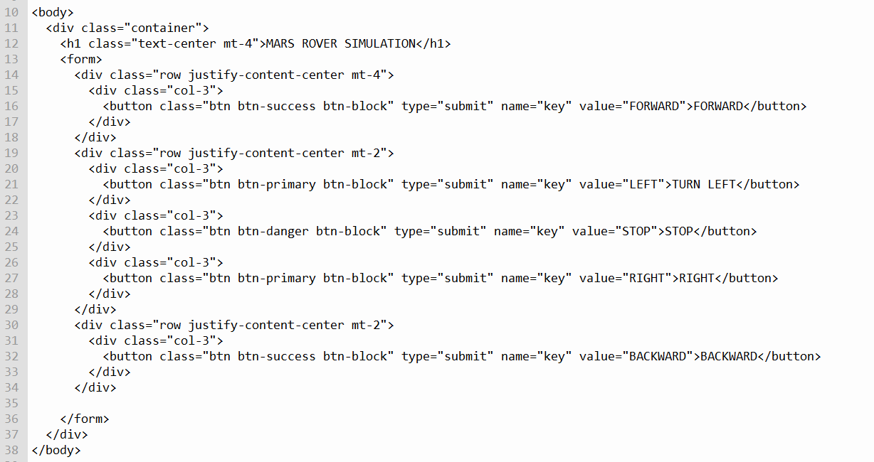
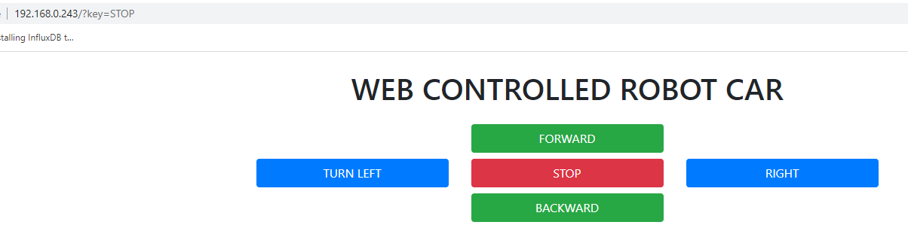
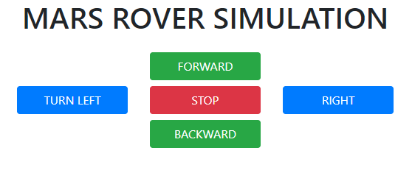

Slide 11
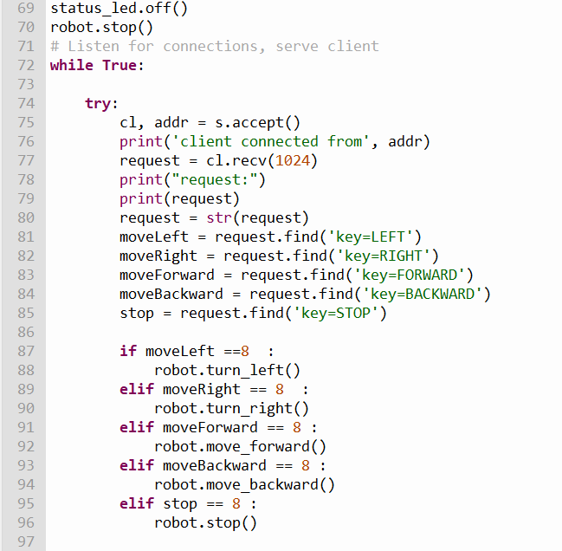
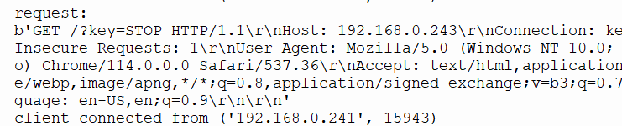
192.168.0.243?key=STOP

Slide 12
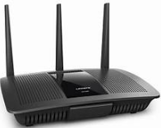

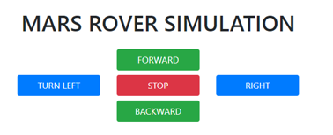
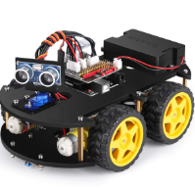

LOCAL AREA NETWORK
SSID:VirusGenerator
PWD : VGAquarius090317
192.168.0.243

Slide 13
CHATGPT
give me a html page using bootstrap.
1 FORWARD submit button in green value ='FORWARD’
1 BACKWARD submit button in green value = 'BACKWARD’,
1 LEFT submit button in blue value ='TURN LEFT’,
1 RIGHT submit button in blue value ='TURN RIGHT' and
1 STOP submit button value='STOP' in red in the middle of these 4 buttons.
Add a caption on top of these button : WEB CONTROLLED ROBOT CAR.
all buttons belong to same group name 'key'

